Slide 1
Title II & YOU
Quick fixes & supports for remediating your course materials
Lisa Sieg & Morgan Vickery

Slide 2
Why do this just for 1-2 students?
why Title II isn't just about compliance

Slide 3
Title II is a section of the Americans with disabilities act
Title II is a section of the Americans with Disabilities Act
The students who show up are putting in SO MUCH LABOR just to be here
They want to be here. They are fighting to be here.
Let's make sure they aren't left behind!
Notes:
This is the "why should I care" framing. Title II of the ADA requires that public entities — including our institution — make programs, services, and activities accessible to people with disabilities. In practice, for us as instructors, that means the digital materials we post (slides, PDFs, Word docs, Brightspace pages) have to be usable by someone using assistive technology, not just by someone who can see a mouse and read plain text off a screen.
The reason to care isn't just "it's the law" (though it is). Every student who registers for your class and shows up with a disability has already cleared enormous hurdles to be there — arranging accommodations, advocating for themselves, sometimes fighting a system that wasn't built with them in mind. When a course material is inaccessible, we're adding one more barrier on top of all of that, often without meaning to. A few small habits on our end remove that barrier before the student ever has to ask.

Slide 4
But...I don’t have any blind students?
Title II accessibility a puzzle piece in our effort to "do better for folks who are disabled!
We can also be 'disabled' by our environments & situations!
auditory
cognitive
neurological
speech
visual
developmental
orthopedic
emotional
learning
memory
multiple
hearing
Device limitations (mobile phones, smart watches, smart TVs, or other small/alternate-input devices)
Aging (changing physical abilities
Temporary disabilities (broken arm, lost glasses, concussion)
Situational limitations (bright sunlight, can't use audio)
Slow/limited/expensive internet
Device access (outdated operating systems, shared devices, limited permissions)
Notes:
A student reading your PDF on their phone between shifts benefits from proper headings the same way a screen-reader user does. A student with a concussion or migraine benefits from good color contrast the same way a colorblind student does. Captions help a student watching lecture videos in a loud dorm room just as much as a Deaf or hard-of-hearing student. The point isn't "there's no disabled student in my class so I can skip this" — it's that you usually can't know, and the fix helps everyone regardless.

Slide 5
So...what does this impact?

Slide 6
Whose materials? Where?
Lecture slides
File uploads
(PDFs, Word docs, PowerPoints)
Anything else students are required to read, view, or interact with for the course!
Brightspace content pages
(text typed directly into Brightspace)​
Lecture Recordings

Slide 7
I think my materials are inaccessible!
How we can help you, and how you can help yourself!

Slide 8
"Checker" tools
Tool | What it's for | More Information
Ally (in Brightspace) | Automatic accessibility score/report on your course files — tells you exactly what to fix and where | Using Ally in Brightspace
Word / PowerPoint | Built-in accessibility checker for text-based documents and slides
Brightspace accessibility checker | Built-in checker for content typed directly into Brightspace pages | Improve your course with Brightspace accessibility checker
Notes:
ou don't have to fix everything by eye or catch every issue yourself. Ally is your starting point for anything already in Brightspace — it scans your files automatically and gives you a plain-language "here's what's wrong and here's how to fix it" report with a score, so you're not guessing where problems are.
From there, the right tool depends on the file type: video captions go through YuJa, PDFs get remediated in Adobe Acrobat, and Word/PowerPoint files have their own built-in accessibility checkers under the Review tab. If content lives directly on a Brightspace page rather than in a file, Brightspace's own built-in checker (in the content editor) will flag issues there.
Two newer/less obvious ones worth knowing about: Copilot can genuinely speed up tedious remediation tasks like drafting alt text or reorganizing headings — treat its output as a first draft to review, not final. And MathPix is specifically for handwritten or scanned math — it converts equations, proofs, and symbols into accessible, searchable text instead of an unreadable image.
If you get stuck or Ally flags something you don't know how to fix, that's what the REACH office/website is for — you're not expected to become an accessibility expert overnight.

Slide 9
Remediation Tools
Tools that help you fix what the checkers find:
YuJa | Auto-captions for videos; generates searchable text and transcripts; already integrated with Brightspace!
Adobe Acrobat | Remediating PDFs (tags, reading order, alt text)
MathPix | Converts handwritten math symbols, equations, and proofs into accessible, searchable text
Notes:
YuJa handles anything video — it auto-generates captions and a searchable transcript, which benefits Deaf/hard-of-hearing students but also anyone reviewing lecture footage for a specific moment instead of rewatching the whole thing.
Adobe Acrobat is where PDF remediation happens — tagging headings, fixing reading order, adding alt text to images inside the PDF. Our PDF accessibility guidelines page (linked above) is a good starting reference, and also flags that the university is reducing PDF use where possible — worth asking whether a Brightspace page or Word doc could replace a PDF instead of remediating it.
MathPix solves a problem the other tools don't: handwritten or scanned math. If you've got equations, proofs, or symbols in a photo or scan, MathPix converts them into real, accessible, searchable text instead of an image a screen reader can't parse at all.

Slide 10
Some resources
CTL Drop-Ins & Consultations
What instructors need to know about Title II accessibility
Using ReadSpeaker in Brightspace
Extra time on assignments -- accommodations in Brightspace
Viewing student accommodations in Brightspace
Extra time / alternative days for exams -- accommodations in Brightspace

Slide 11
Work smarter, not harder!
Create a system that future-you will thank you for :)

Slide 12
Pro-tips for being proactive
Centralize your files/materials in one place
Avoid content duplicates — create/edit in one location
Don't mix old & new — track what has/hasn't been remediated, do one big import
Look up existing library materials from publishers who've already remediated their content
Figure out your content first, then find already-remediated materials that cover it
Notes:
Remediation is a lot less painful if you do it once, deliberately, than if you patch things piecemeal every semester. A few habits that pay off:
Centralize. If your syllabus readings live in three different folders, a shared drive, and your email attachments, you'll remediate the same file three times without realizing it. Pick one home for course materials and work from there.
One source of truth. Edit the original file, not a copy. If you find yourself with "Chapter 3 Notes," "Chapter 3 Notes FINAL," and "Chapter 3 Notes FINAL v2," you're setting yourself up to accidentally post an unremediated version.
Don't mix remediated and un-remediated content in the same import. If you're moving materials into a new semester's course, do it as one clean pass — remediate first, then copy over — rather than dragging old files in as-is and fixing them later. "Later" tends not to happen.
Check the library first. Many textbook publishers and library-licensed content are already remediated to accessibility standards. Before you spend an hour fixing a scanned PDF chapter, check whether the library has an accessible version of that same content.
Content before format. Decide what you need to teach first, then go looking for a version of that content that's already accessible — rather than remediating whatever you happen to already have. Sometimes the fastest fix is swapping the source, not editing it.

Slide 13
Where do I even start?
Headings​
Color contrast​
Hyperlinks​
The "low-hanging fruit" of material re-mediation
Image alt text​
Tables

Slide 14
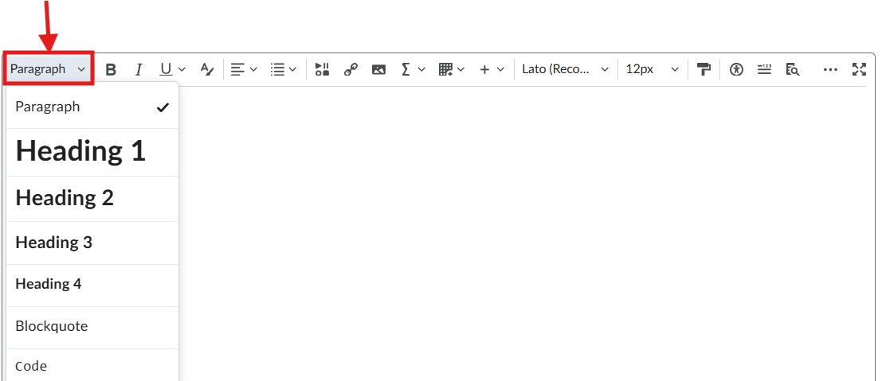
Headings (List for Screenreaders)
Pro-tips / FYIs
Highlight text first
First line is h1
Start at h1 – no lower than h4
Notes:
What does this mean / what is it? Step bystep how to fix it

Slide 15

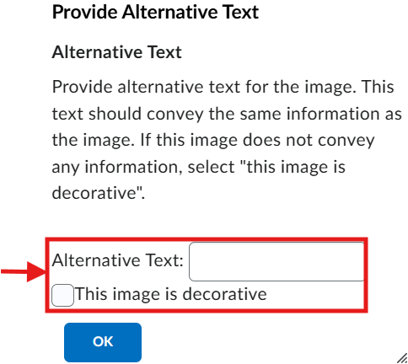
"Alt Text" for Images
Pro-tips / FYIs
Main idea/why an image is used
1-2 sentence summary for
Not needed for decorative images

Slide 16
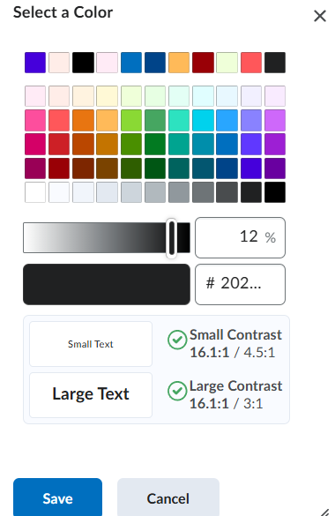

Color Contrast
Pro-tips / FYIs
High contrast
Color + Black
Notes:
Yes you can have color with accessibility!
Also you can check your accessibility at any time by clicking on the accessibility icon.

Slide 17
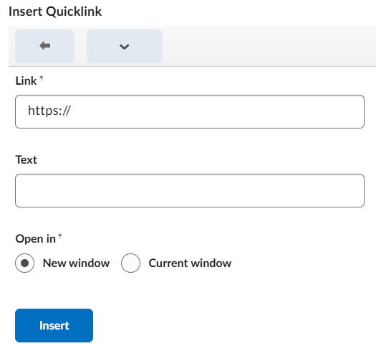

Links, links, & more links!
Pro-tips / FYIs
Use link tool
Include description

Slide 18

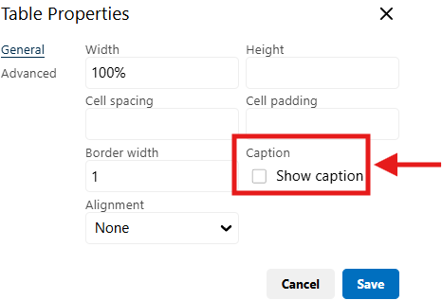
Tables
Need title
Rows/columns labeled
No blank cells

Slide 19
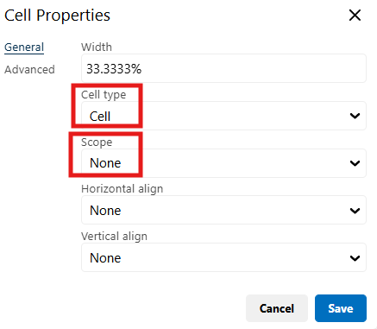
Tables
Label Column/Row
Include Scope if there's a relationship between your columns and rows
Cell -> Cell Properties

